Slide 1


MALLA REDDY
Technical Campus
Balu Shankar -- 25MVCSMR0097
Thrinath – 25MVCSMR0139
Vivek goud – 25MVCSMR0114
Adwaith -- 25MVCSMR0108
Guide Name : Anand Sir
Acadamic Year : 2026-2027

Slide 2


Slide 3


Slide 4


Slide 5
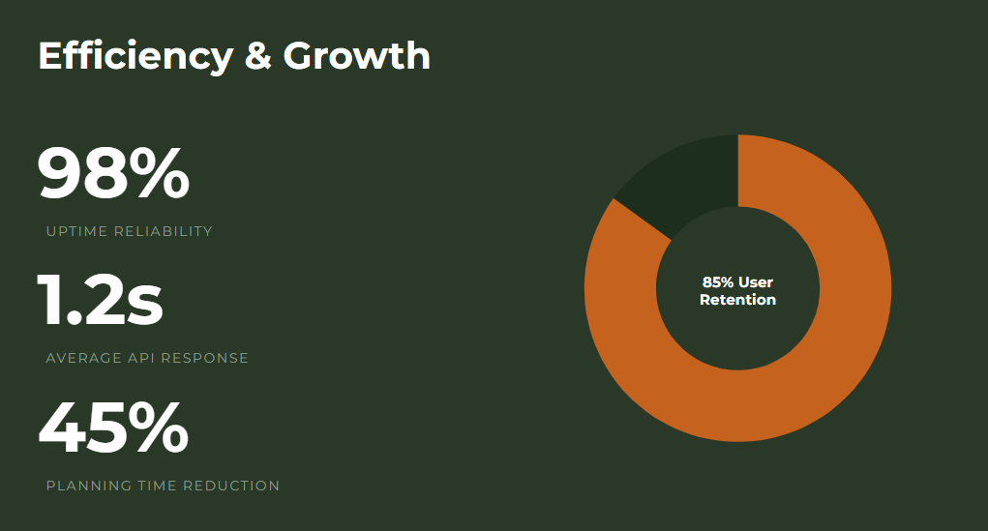

Slide 6
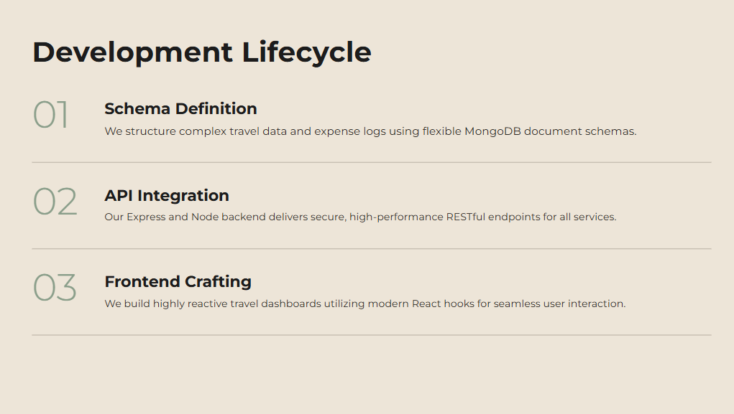

Slide 7


Slide 8


Slide 9

THANK
YOU

